Slide 1
POPULATION AND COMMUNITY Dr Kim Houghton co-CEO Regional Australia Institute

Slide 2
Regional population growth
It is a myth that populations are declining in regional Australia
Across the board regions have grown
But remote regions are losing people
Notes:
Regional populations have grown! 2011 to 2016
Damaging and self limiting myth to say otherwise
Across all regional types
Not the same rate as the metro, but still a positive news story for regional Australia and positive for regional jobs.
Not all are following this dominant trend and there are declines in some places
Sources of decline (youth), sources of gain/rebalance (over 55’s)

Slide 3
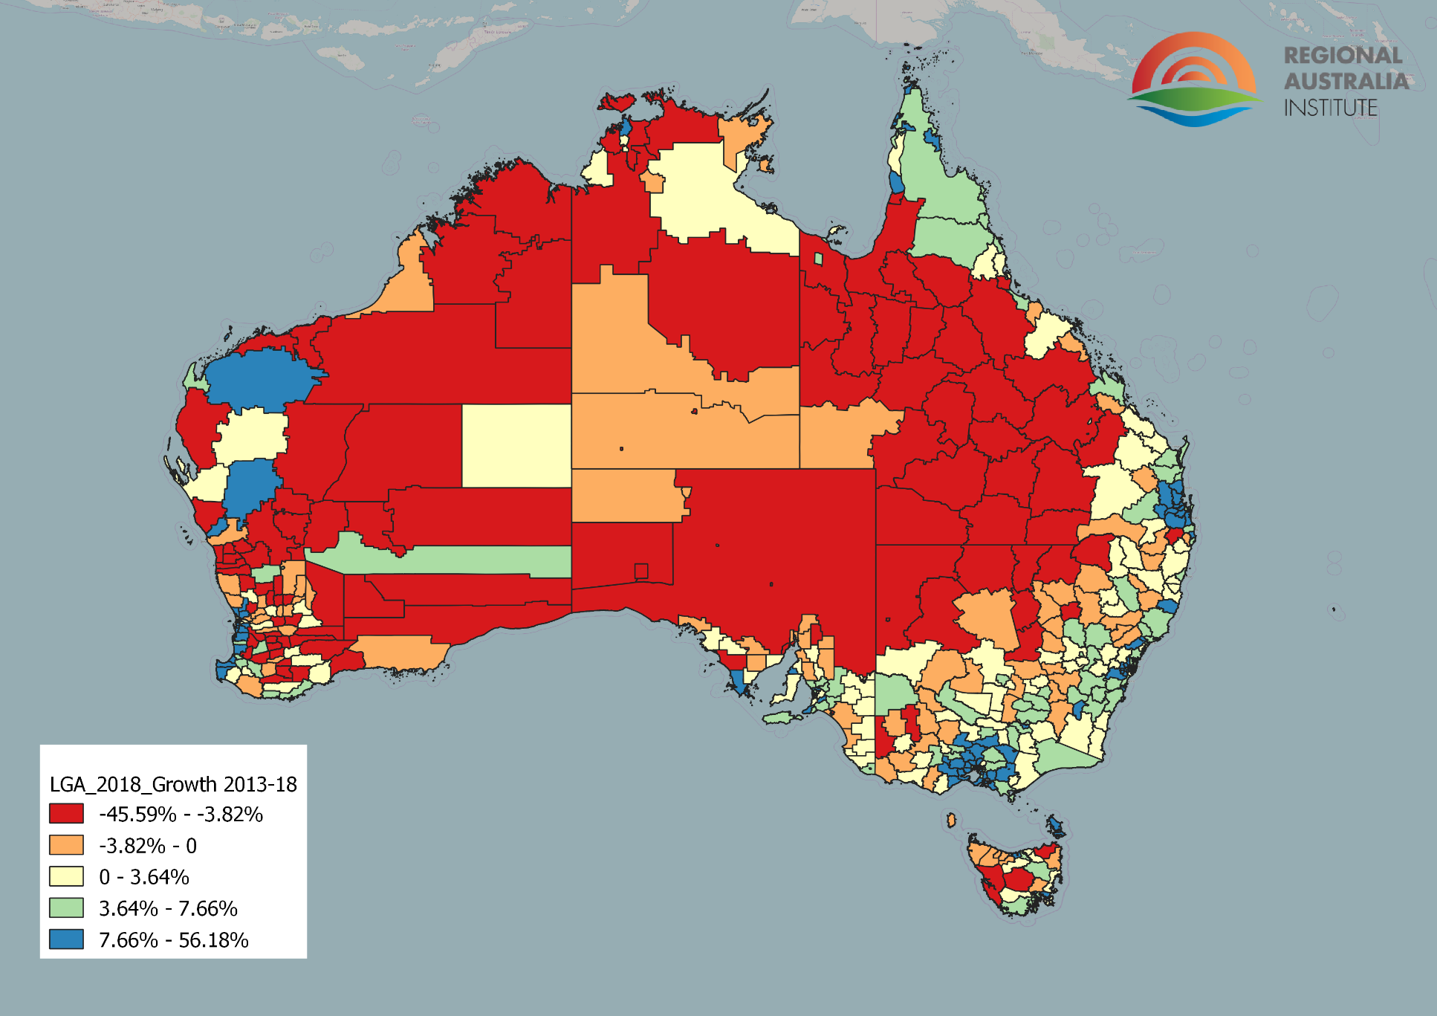
Population change 2013-18

Slide 4
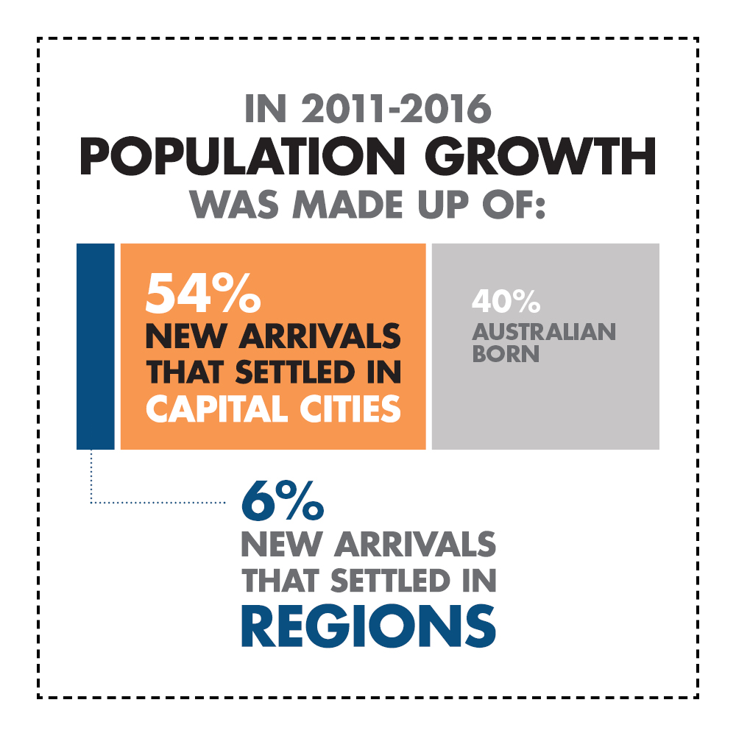
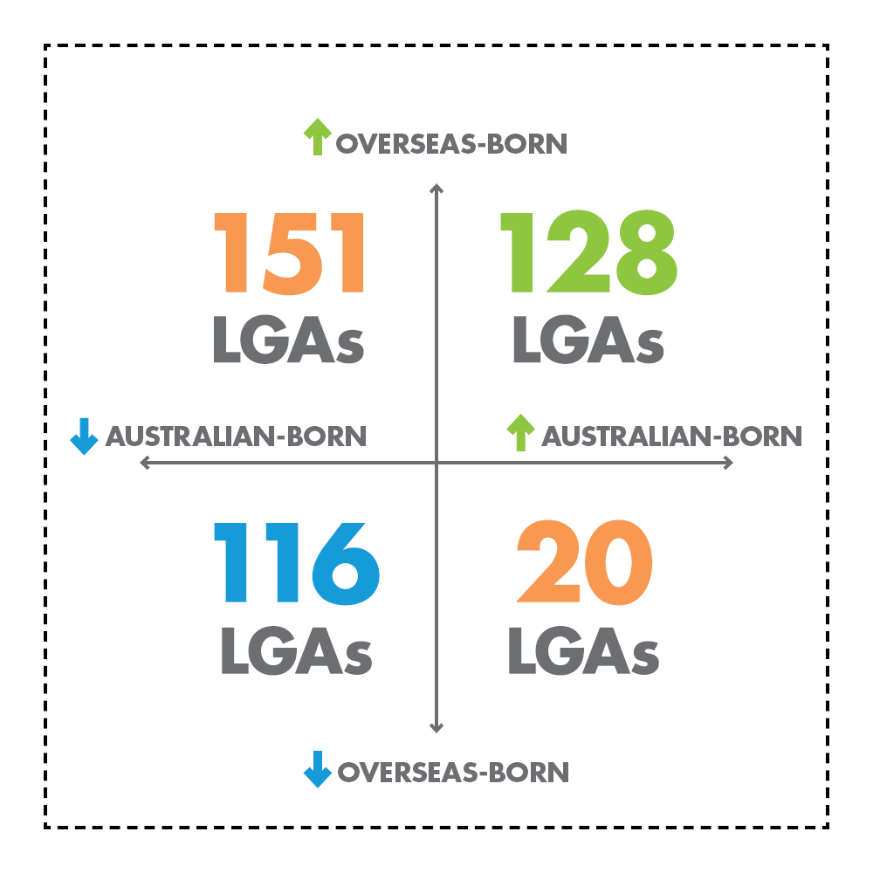
New migrants and regions

Slide 5
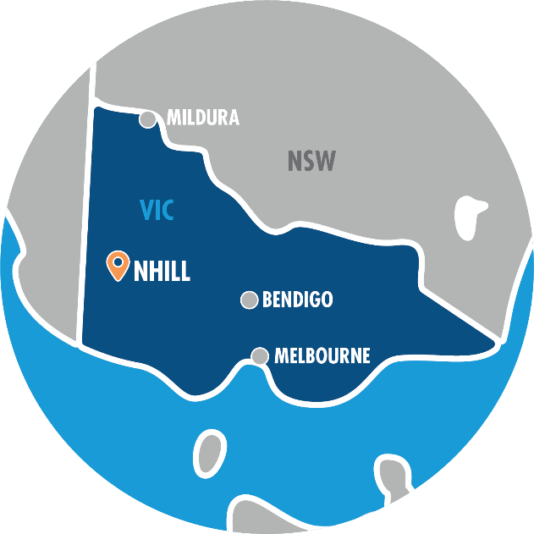
Migrants and small places
In Mingoola, northern New South Wales, nearly 30 African migrants have moved to the town, the local school has been saved from closure, and farmers now have a small workforce to tap into. These African families are building a commercial garlic enterprise to help them become self-sufficient, and bringing renewal to this rural district.
In Nhill, Victoria (population 2,200), more than 200 Karen migrants now call this town their home. For almost a decade this community has been settling families and filling jobs that have led to the growth of local industries – most notably Luv-A-Duck poultry farm that employs 50 Karen migrants.

Slide 6
Mobile people
Sydney net internal migration losses for the last five years
Melbourne small net gains

Slide 7
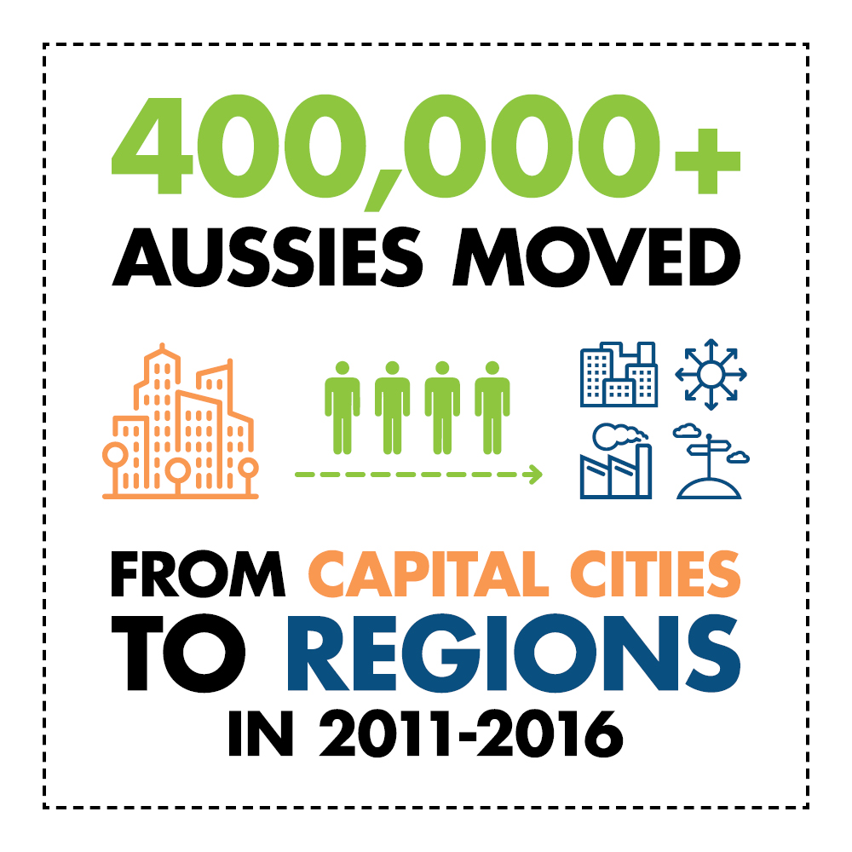
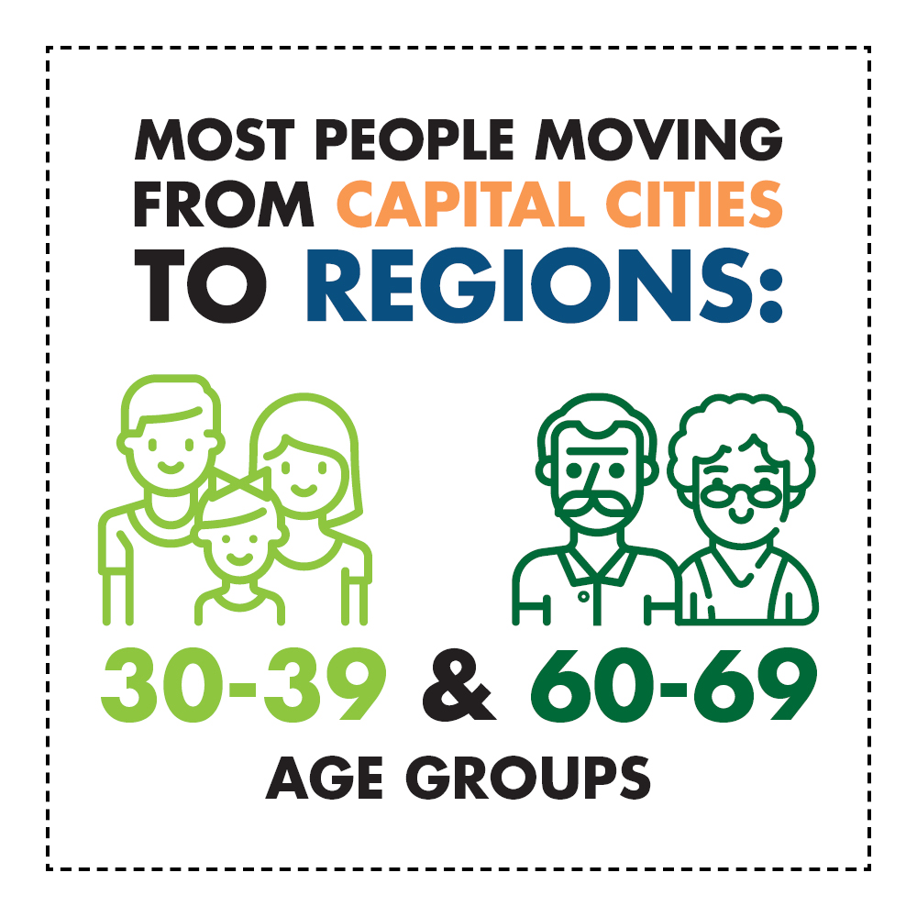
Who is moving to regions?

Slide 8
Work and community
www.regionalaustralia.org.au/home/regional-jobs-vacancy-map/
Over 40,000 job vacancies in regional Australia Feb 2019
Professionals, para-professionals & skilled trades
Vacancy growth rates higher in regions

Slide 9
Attraction and retention
Mobility – people come and go
Attractors:
Cost of living, quality of life, sense of community
Motivators:
Good social infrastructure esp health, education and retail
1 job, series of jobs, career
Breadth and depth in local/regional economy
Cultural vibrancy
Many regions ‘growing their own’
Regional learning systems
Some places will win and others will struggle

